Slide 1
Chapter 11-3: UNIX FILE INTERNEL STRUCTURE
Chapter 4 of
  《the Design of the UNIX Operating System》
  Synchronization
  homework

Slide 2
inode structure
iget
iput
bmap
mamei
super block
ialloc
ifree
disk block alloc and free
free inode and block management

Slide 3
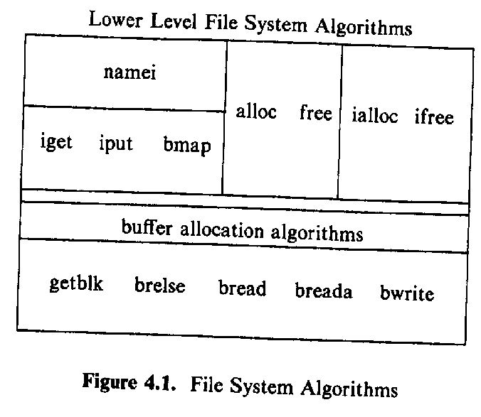
Note
here, when we access disk block, the buffer mentioned last part will exist transparently:
for example, if we say “copy some data from disk to a struct, i-node”, that means :
Disk →buffer → inode

Slide 4
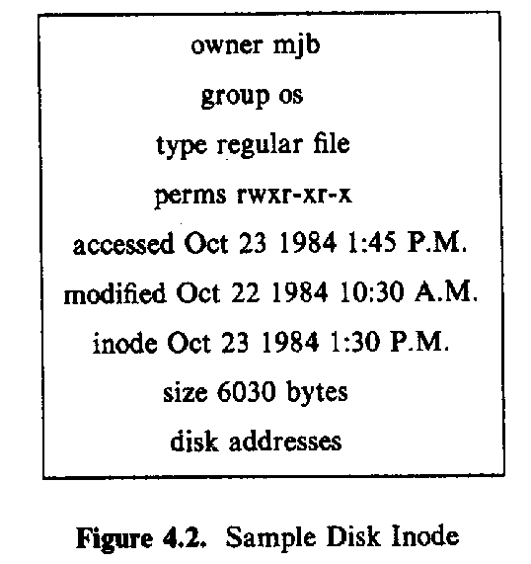
i-node on the disk

Slide 5
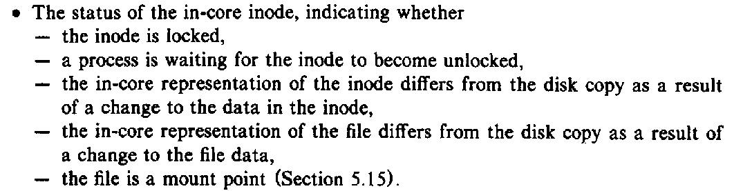

incore i-node
use the almost same mechanism as buffer management

Slide 6
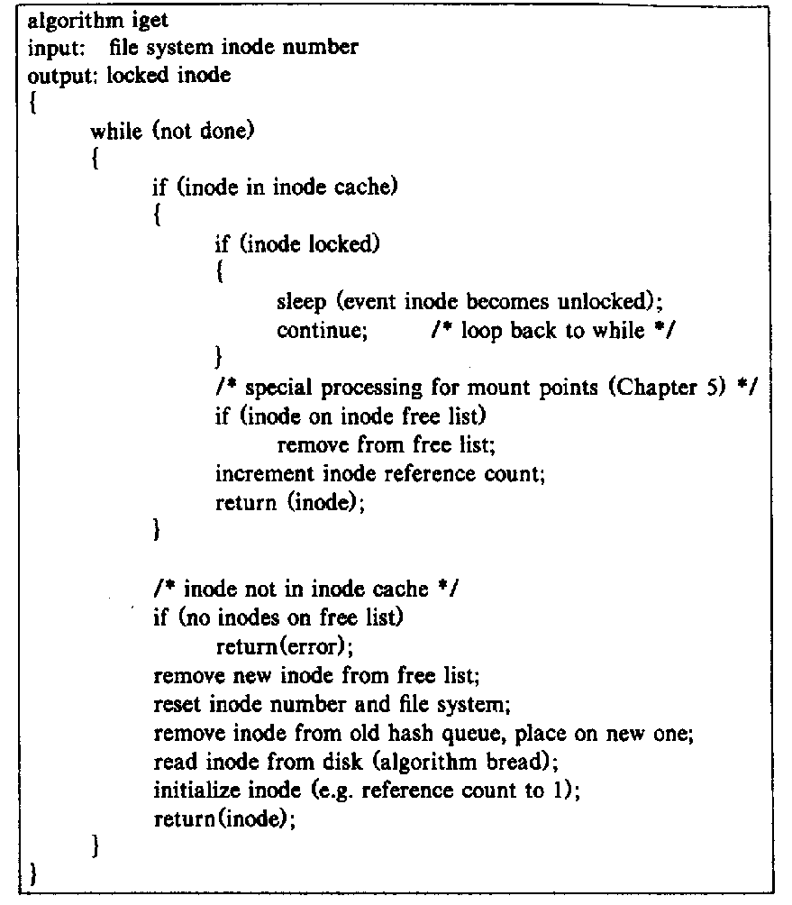
iget algorithm
access file
File name str
Inod
Block num
Reference num
v.s.
lock
Wait v.s.
return error

Slide 7
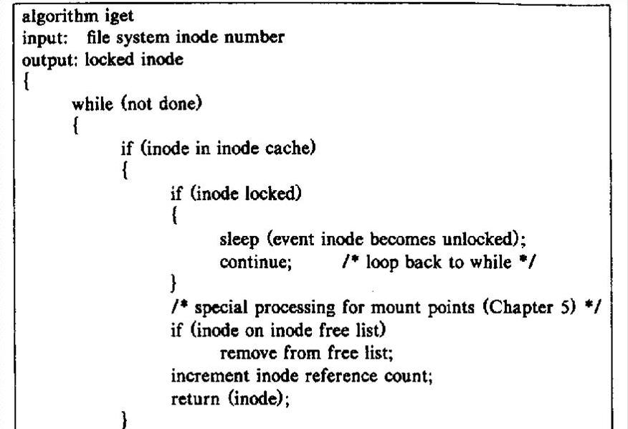

Slide 8
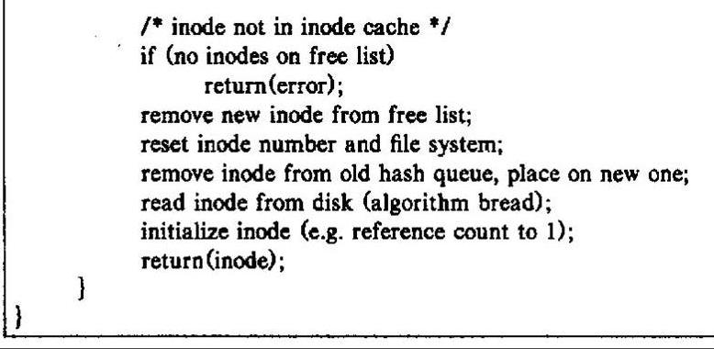
iget (cont.)

Slide 9
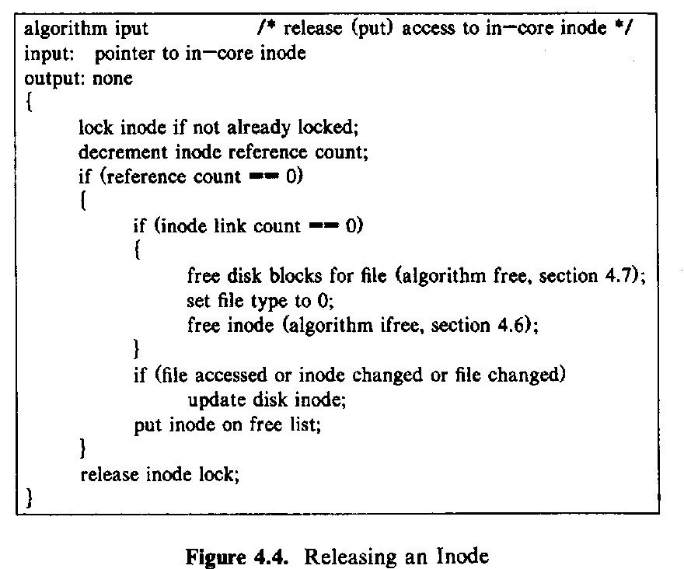
Iput algorithm

Slide 10
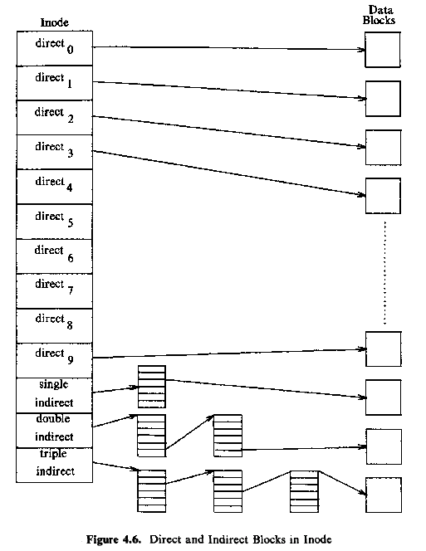
i-node and the data block
10k
256k
64M
16G

Slide 11
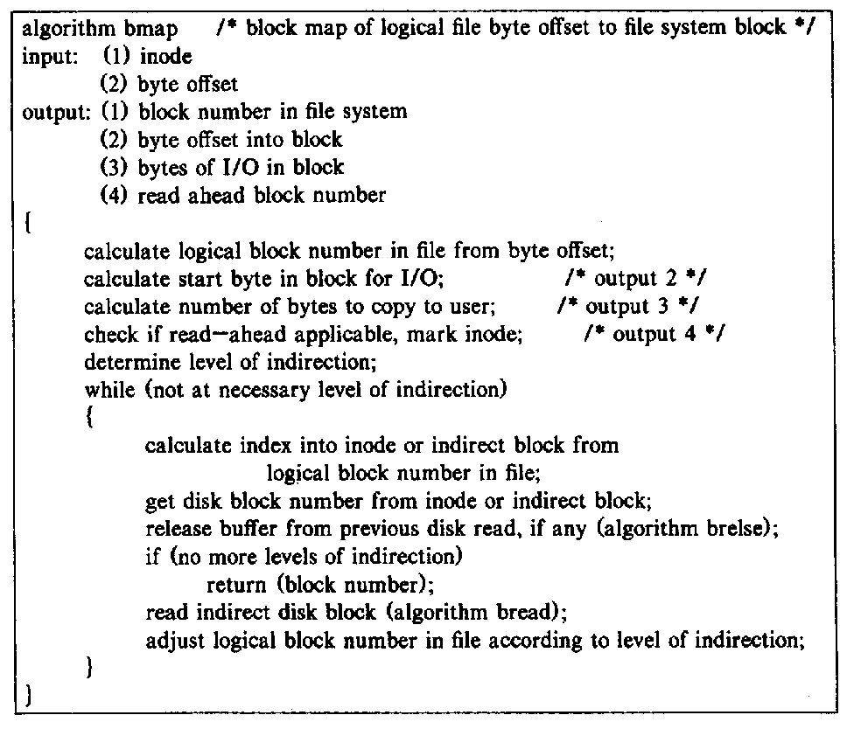
convert logical offset to disk block

Slide 12
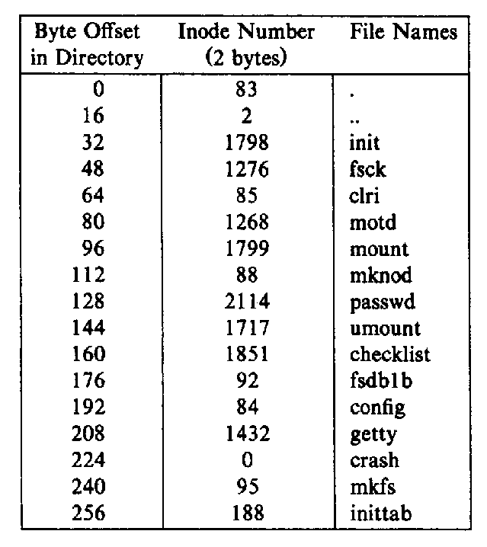
Directory file content
record file
Notes:
here, the directory file is a record file

Slide 13
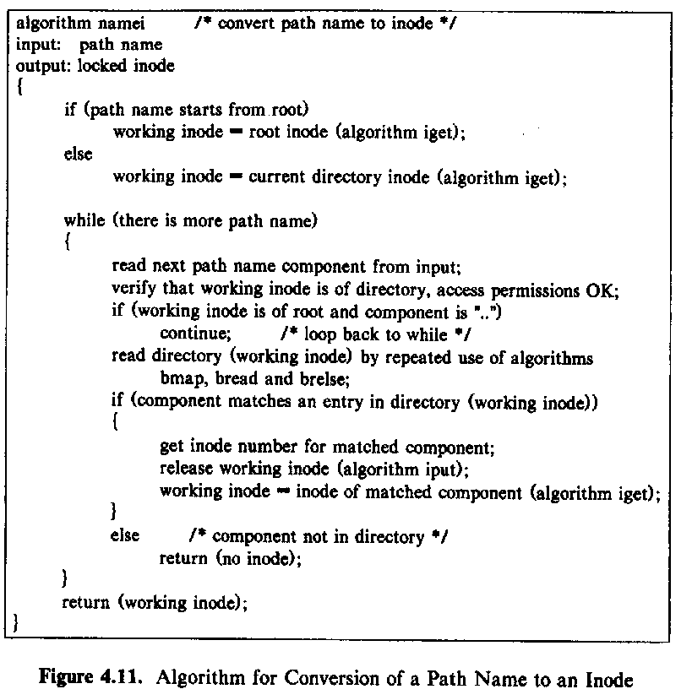
convert path name to i-node
Notes:
test: if we want open file “./home/user1/a.out ”, and use namei to convert the name to inode, how many inode we have to access ?

Slide 14
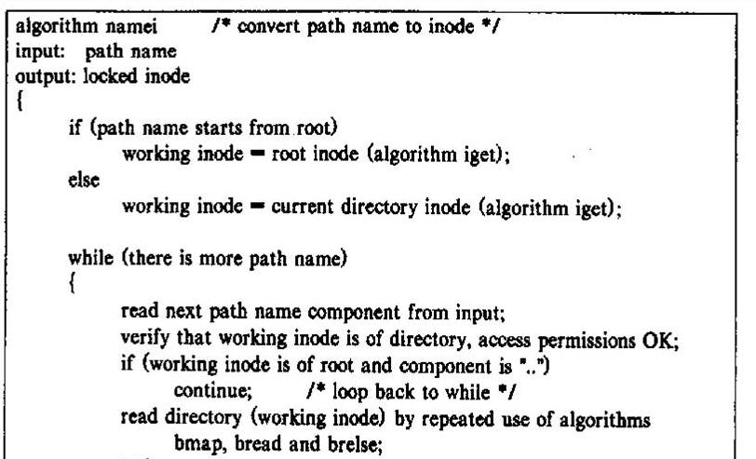
namei -1

Slide 15
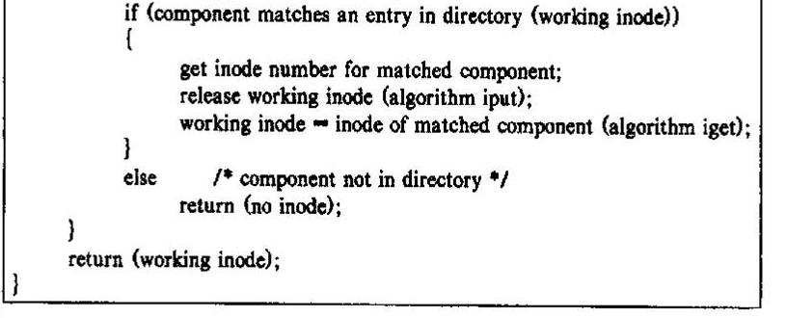
namei --2

Slide 16
discuss: the performance of the directory search
linear search of directory
how is the performance
how to improve (your own answer )

Slide 17
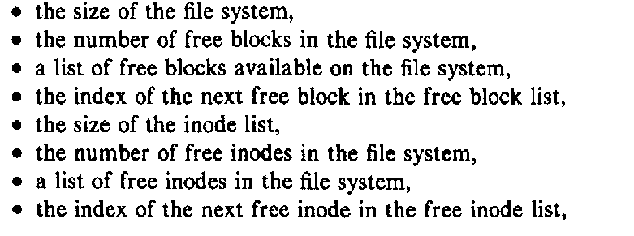
super block

Slide 18
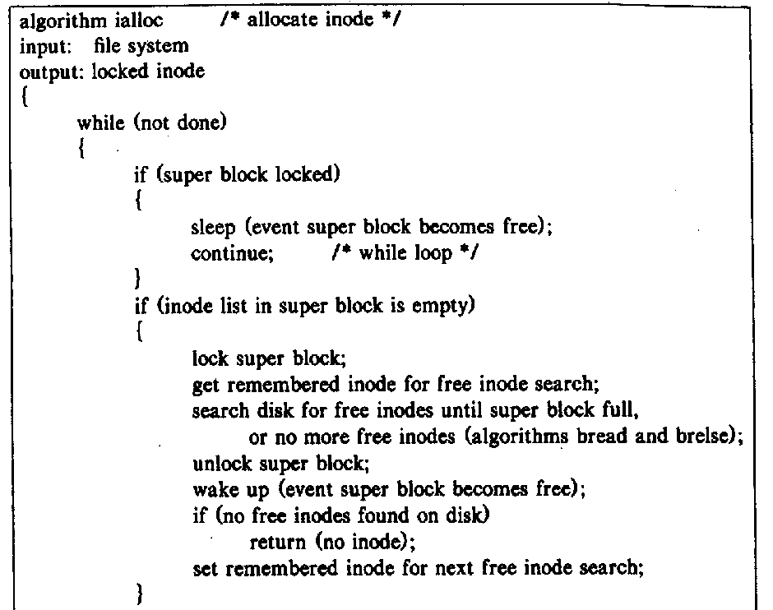
allocate new inode

Slide 19
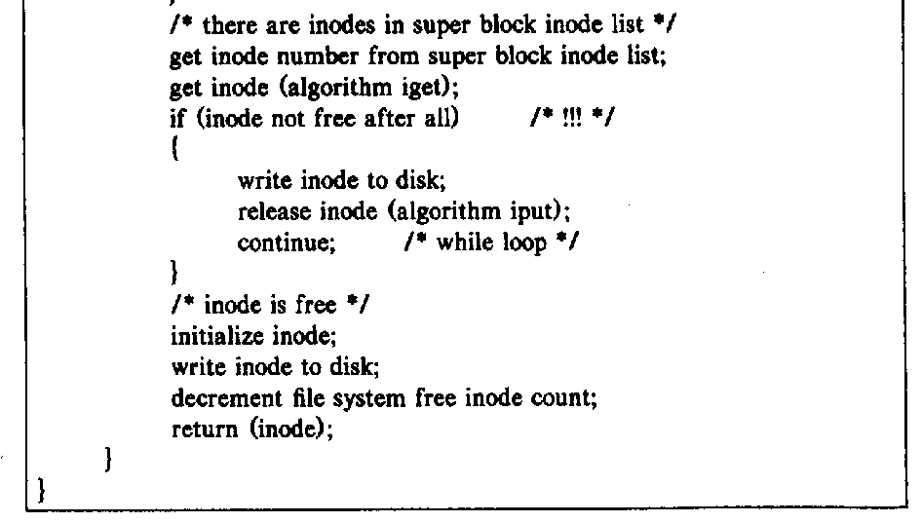
allocate new inode (cont.)

Slide 20
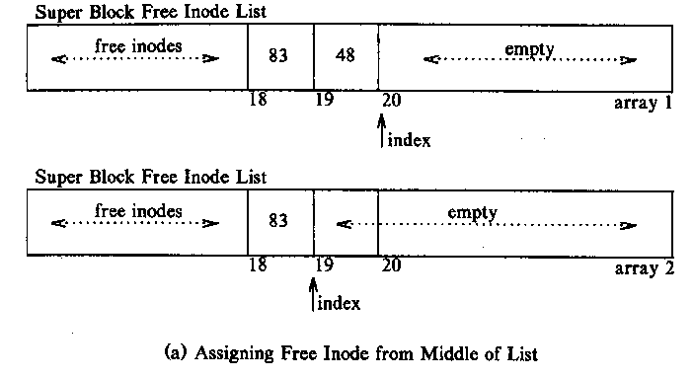
allocate inode from the free inode list

Slide 21
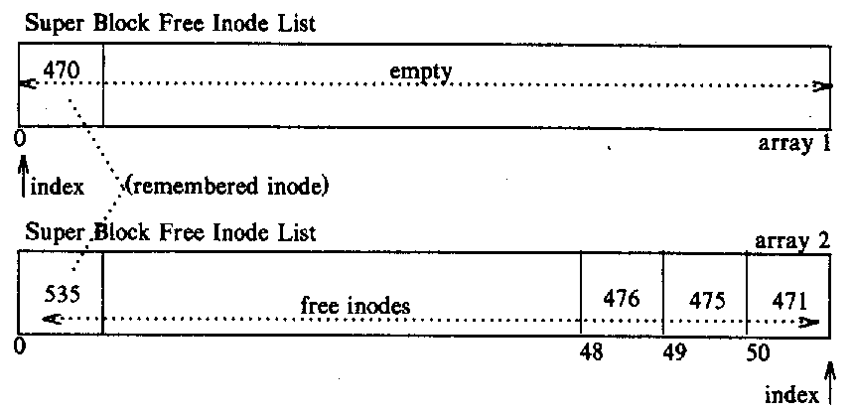
Linked Allocation

Slide 22
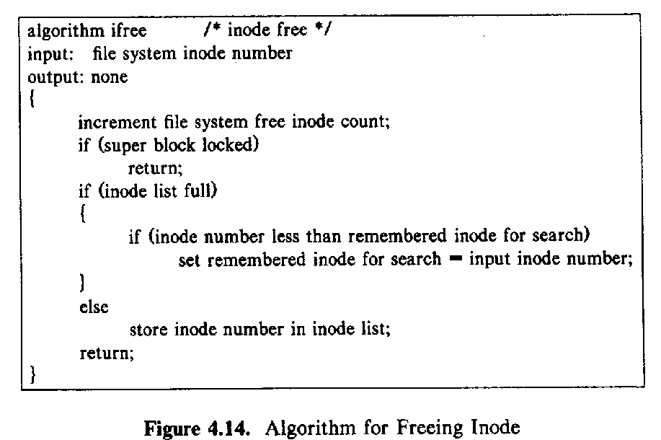
inode free

Slide 23
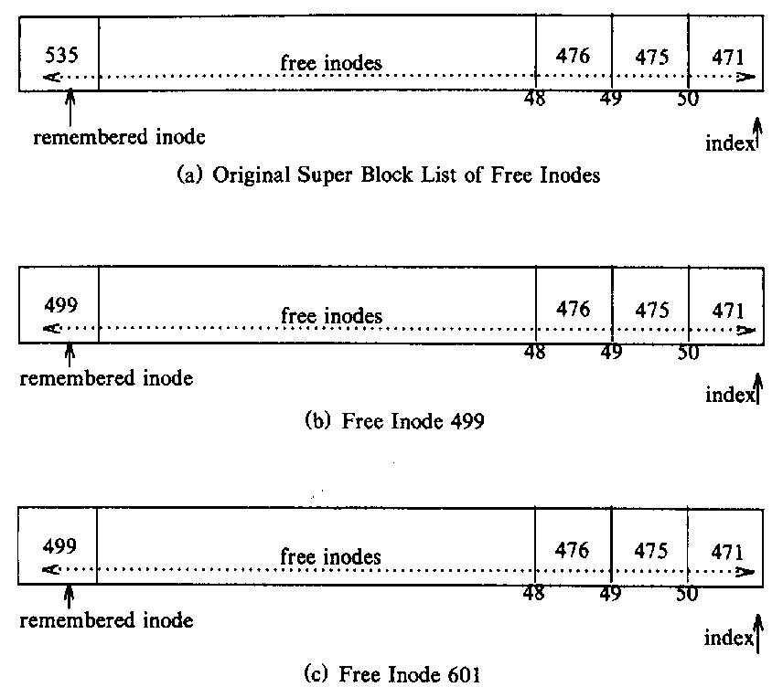
place freed inode number

Slide 24
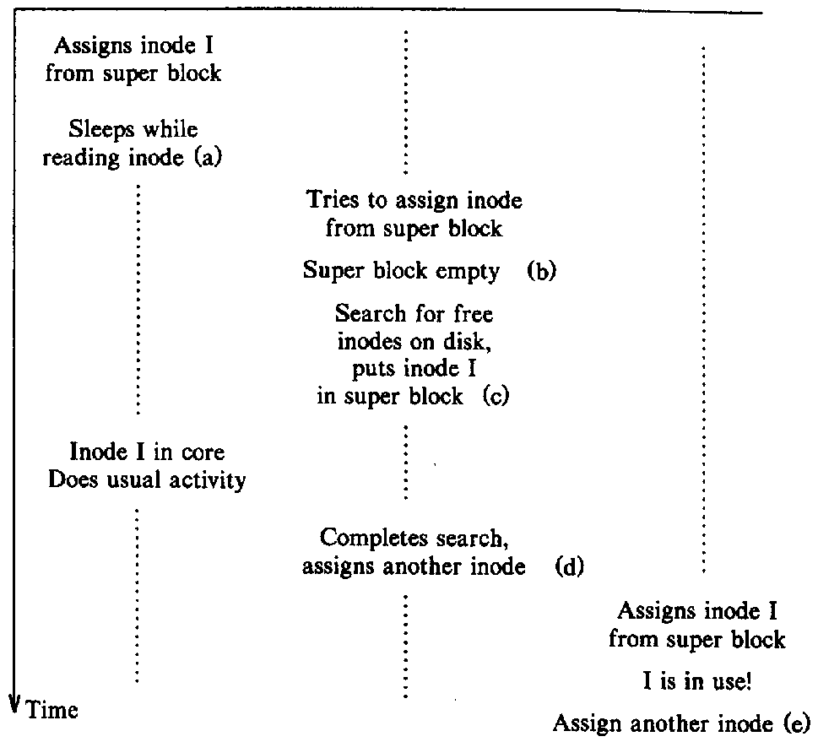
Race condition in assigning inodes (cont.)
lock the common data
write the bufferred data to disk

Slide 25
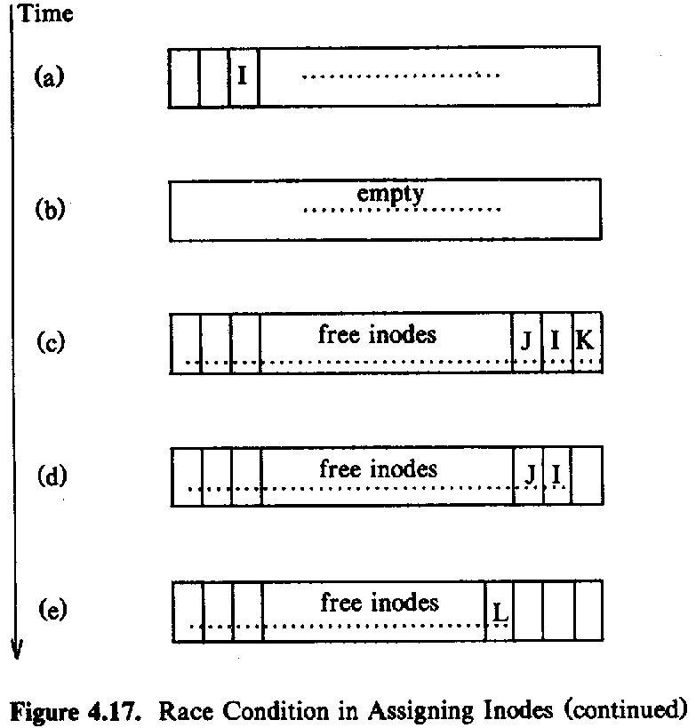
Race condition in assigning inodes

Slide 26
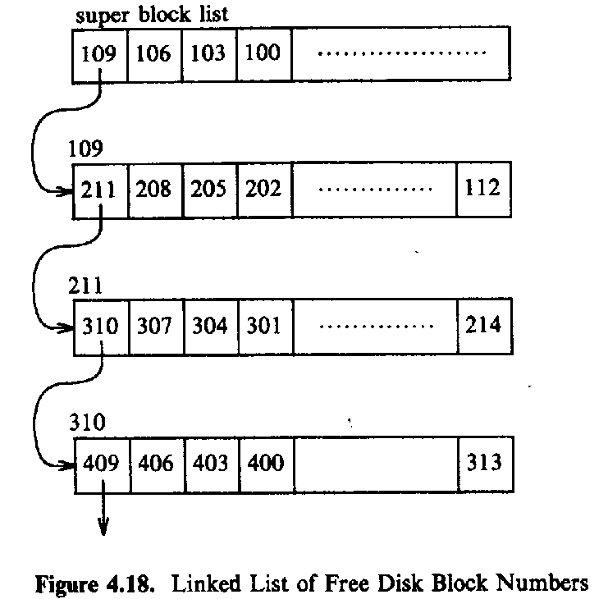
disk block allocation

Slide 27
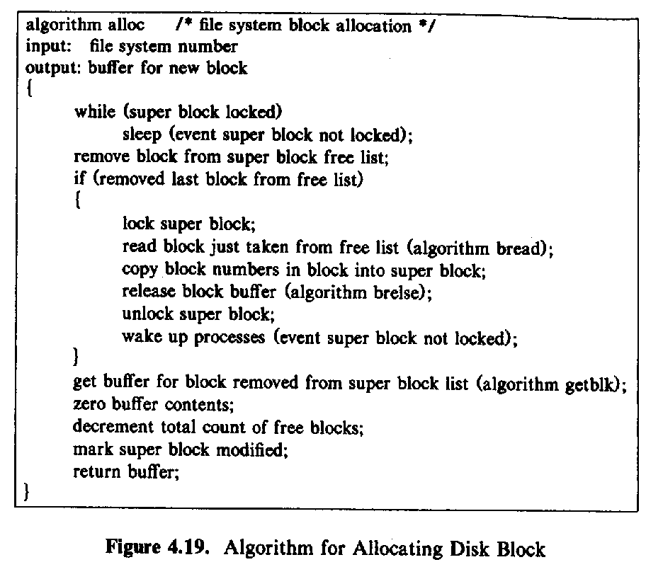
disk block allocate

Slide 28
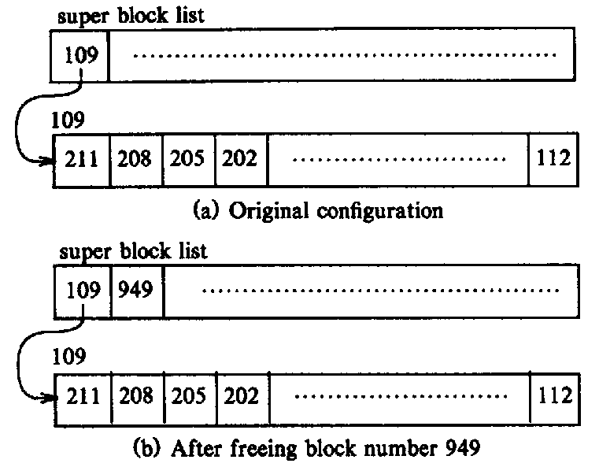
request and free disk block

Slide 29
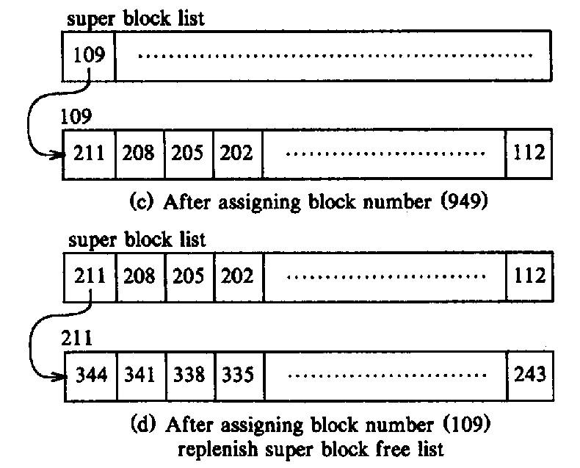
Indexed Allocation (Cont.)

Slide 30
why free blocks is maintained differently from inode ??

